Slide 1

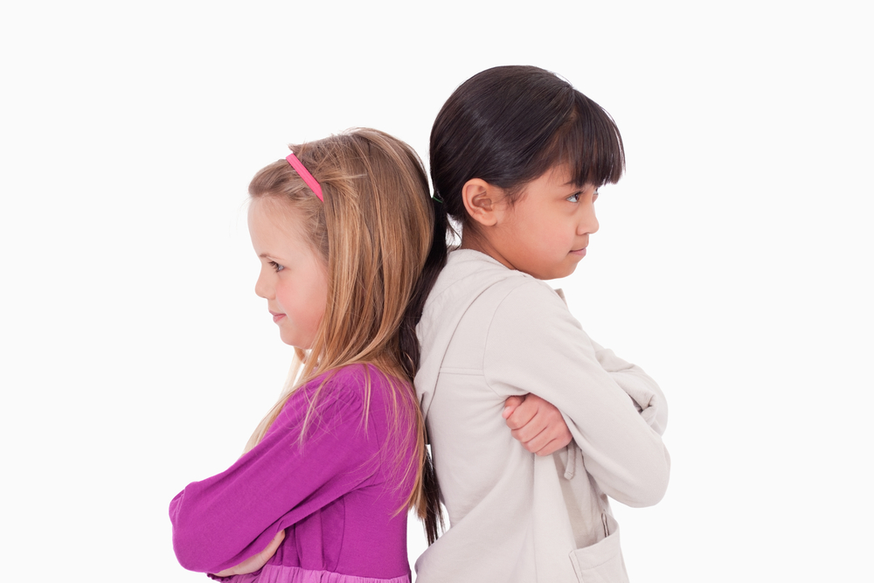
Conflict Resolution

Slide 2
School Expectations
Be Safe
  To be careful and free of danger or harm.
Be Respectful
  To treat others the way you would want to be treated.
Be Responsible
  To be dependable, make good choices and take accountability for your actions.
Be Kind
  To behave in a kind, courteous, and polite manner.

Slide 3
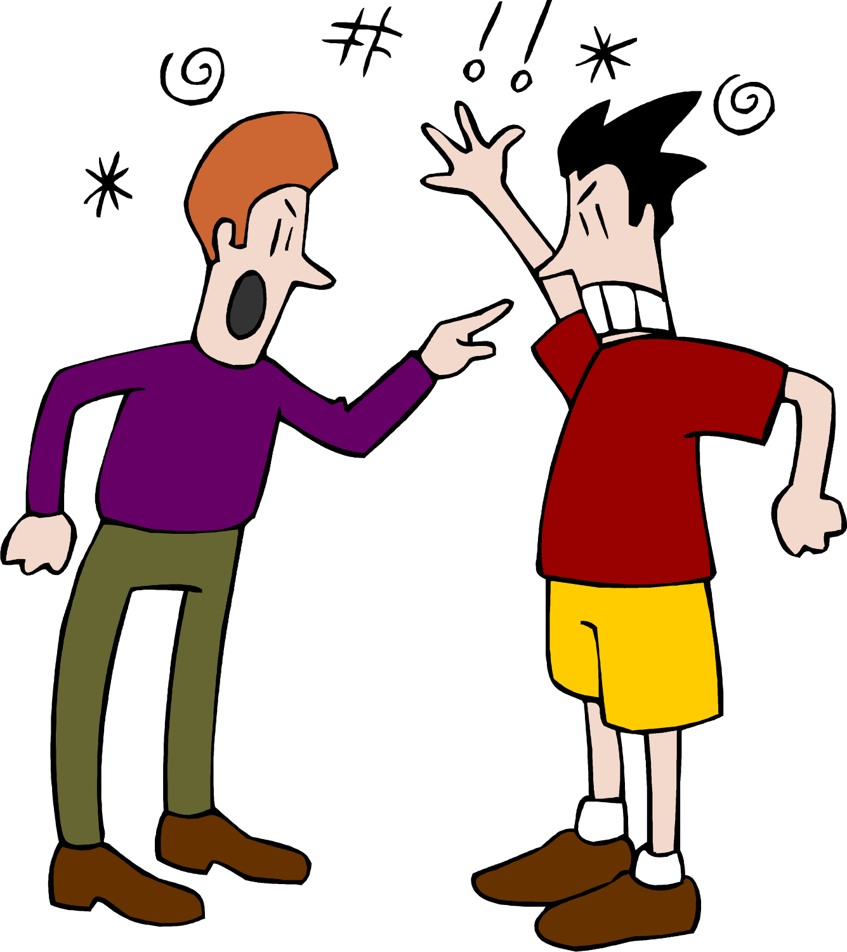
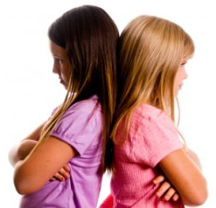
Conflict
Conflict is a disagreement or problem between two people. A conflict can happen when people want, need or expect different things.
Conflict is normal and happens from time to time.
It’s a good idea to solve conflict quickly and fairly before things escalate.

Slide 4
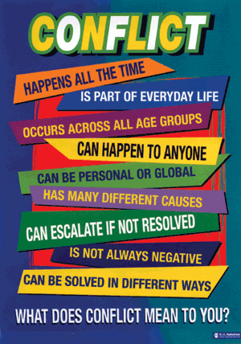
Examples of Conflict
Two people arrive at the front of the line first and both want to be the line leader.
There is a collaborative project in class and the group cannot agree on the topic.
There is rumor going around about two best friends saying mean things about each other. The friends are not talking to each other and are very upset.
Your turn - What is an example of conflict that you have faced?

Slide 5
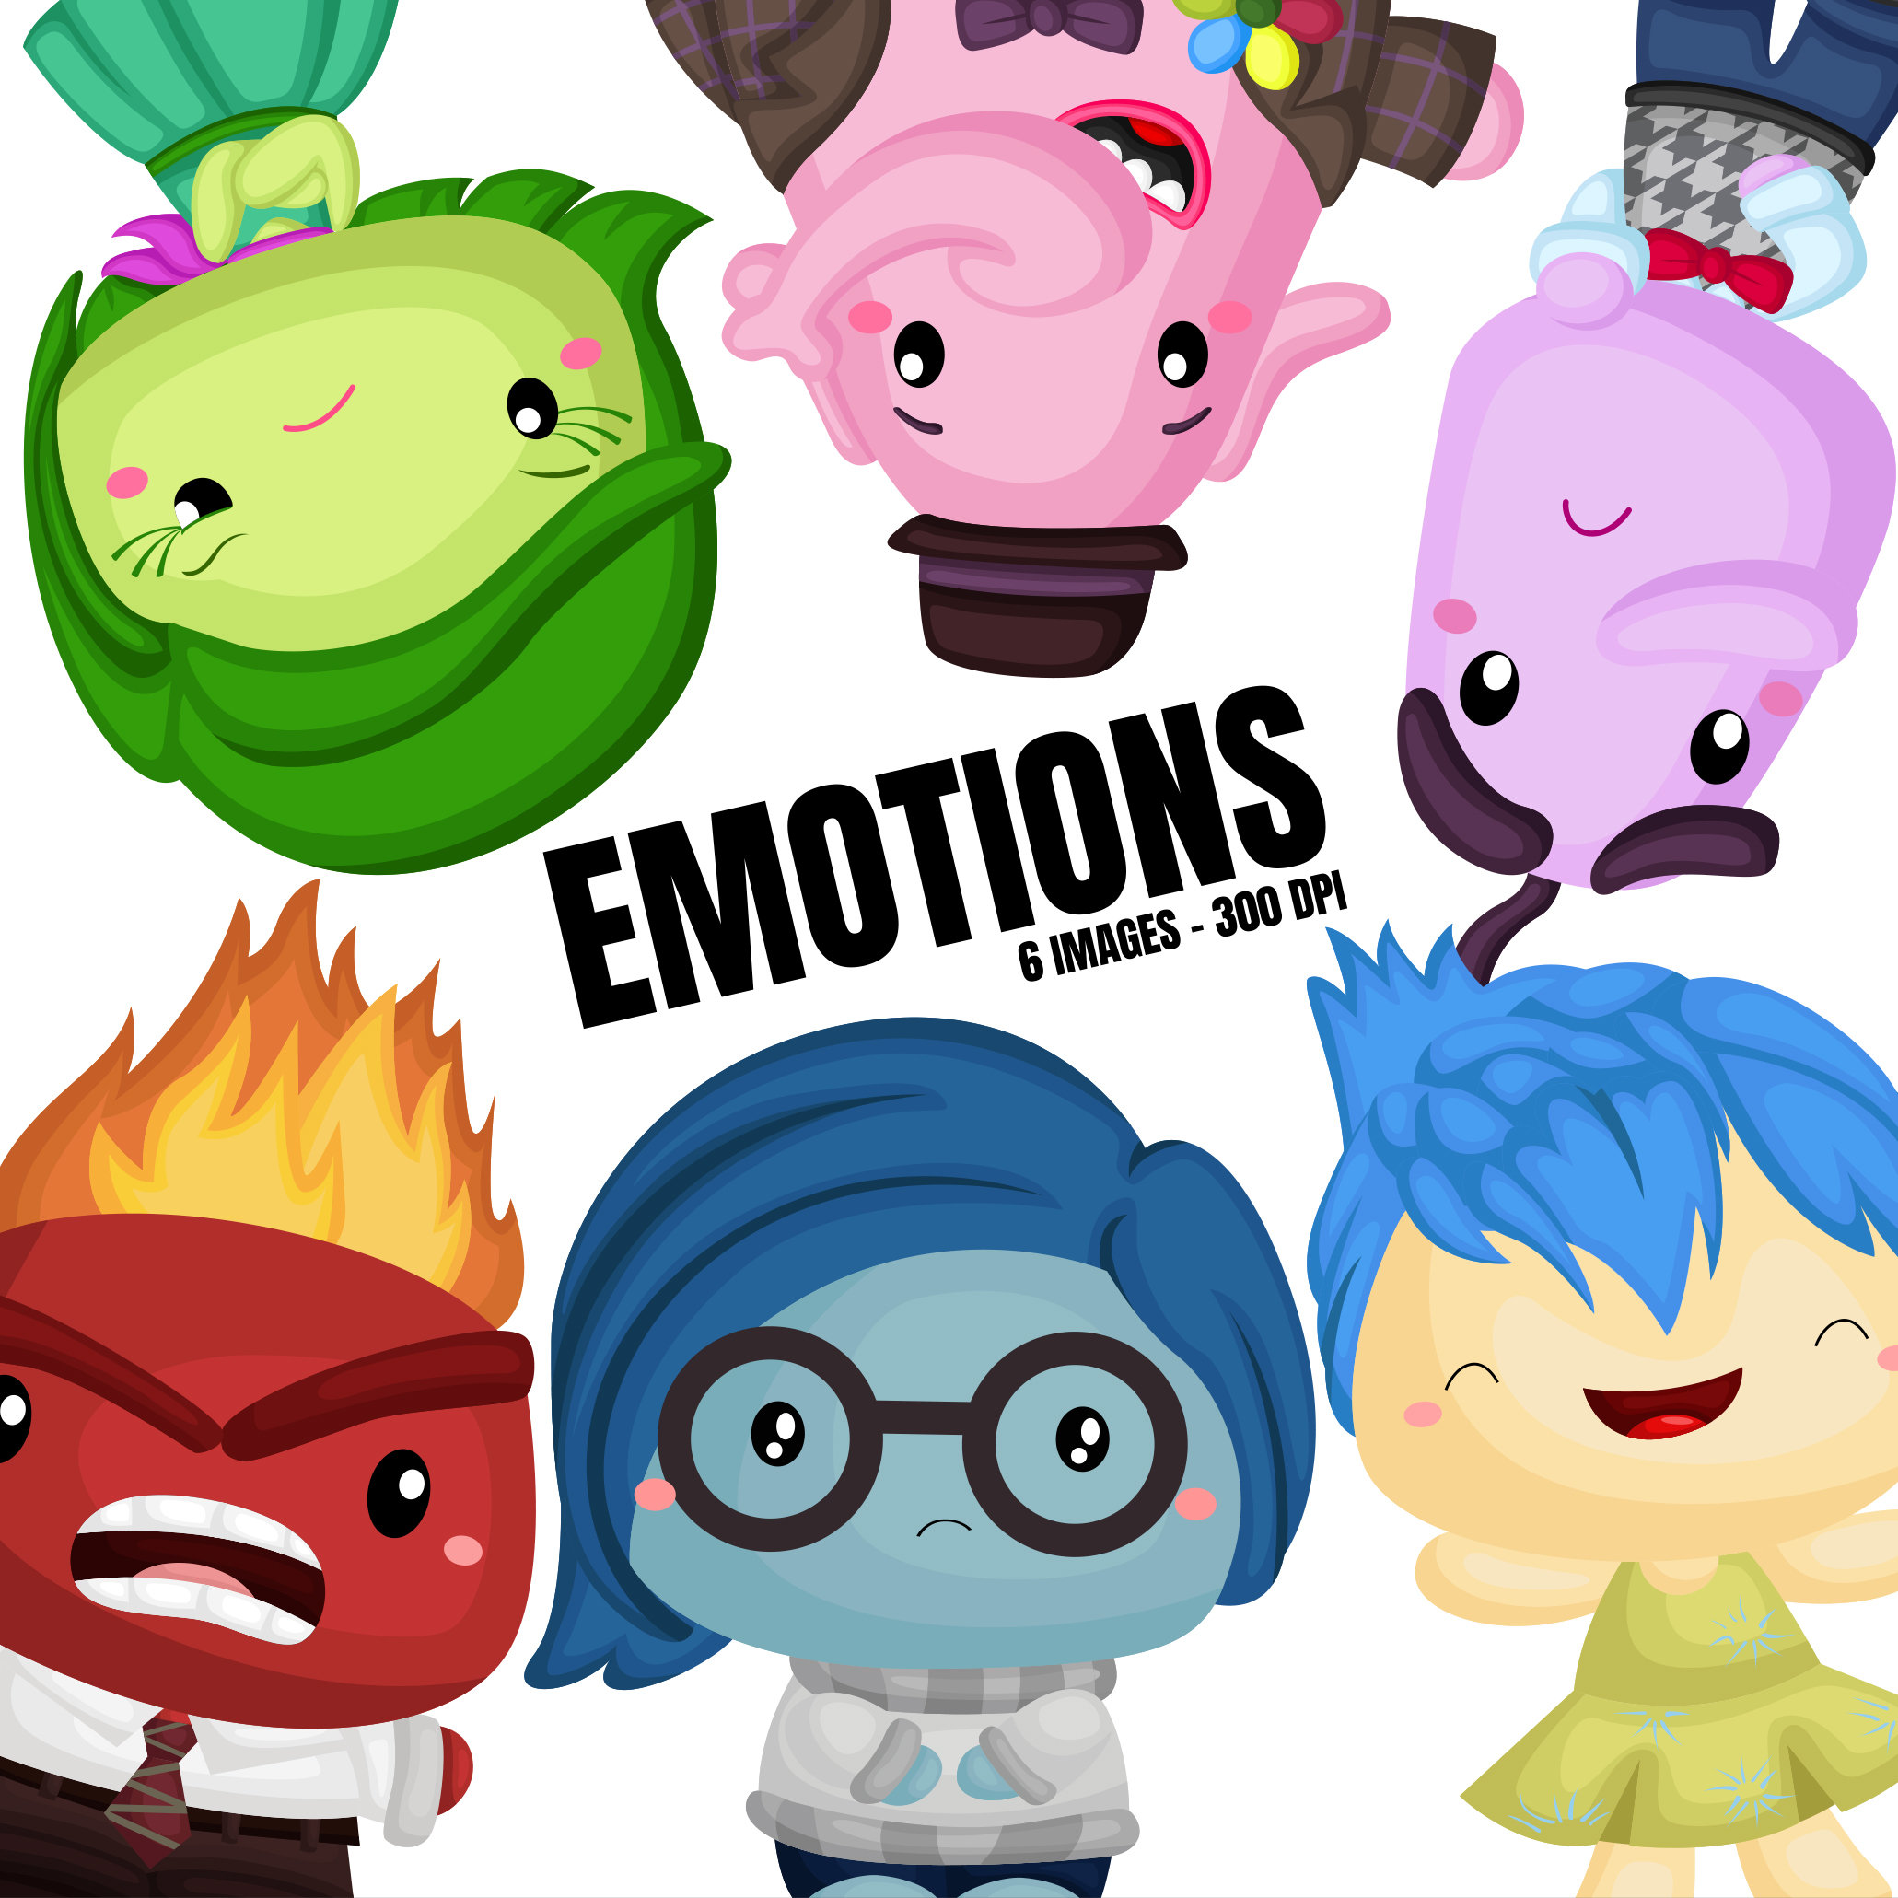
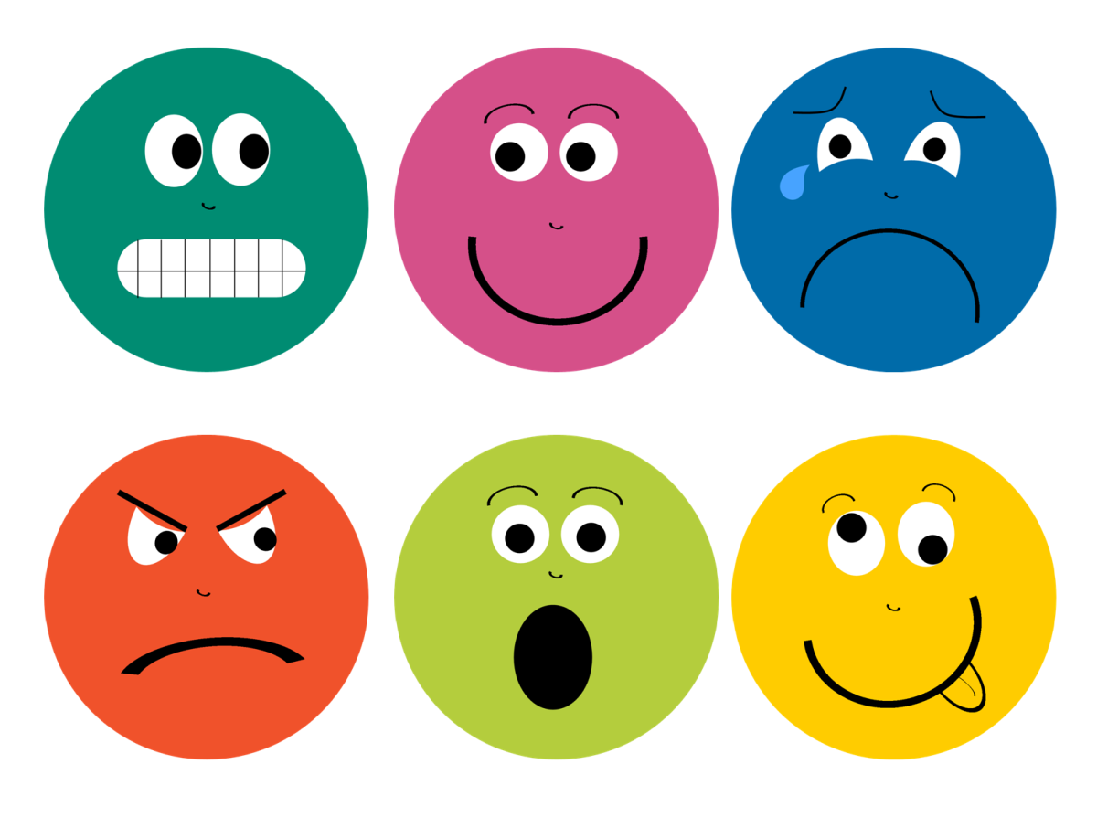
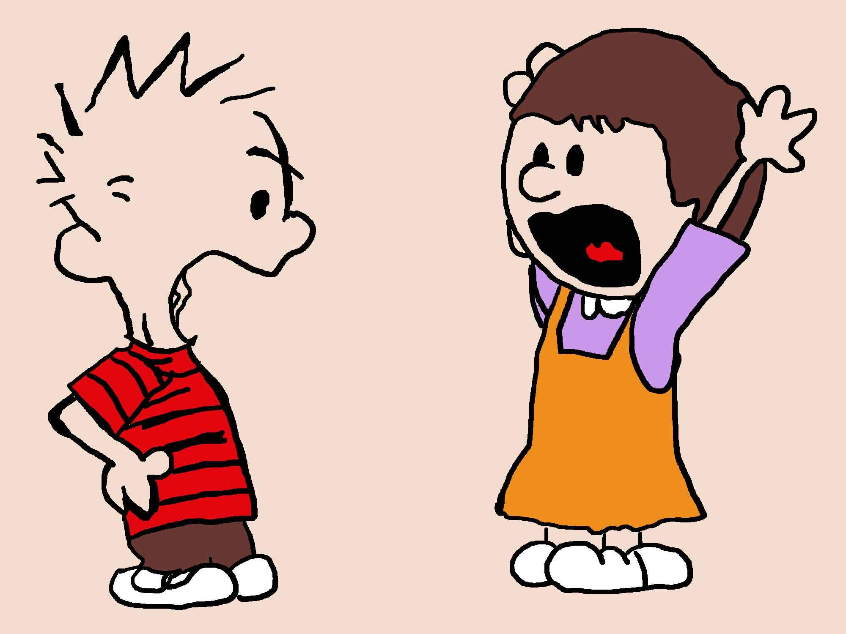
Why should conflict be solved quickly and fairly?

Slide 6
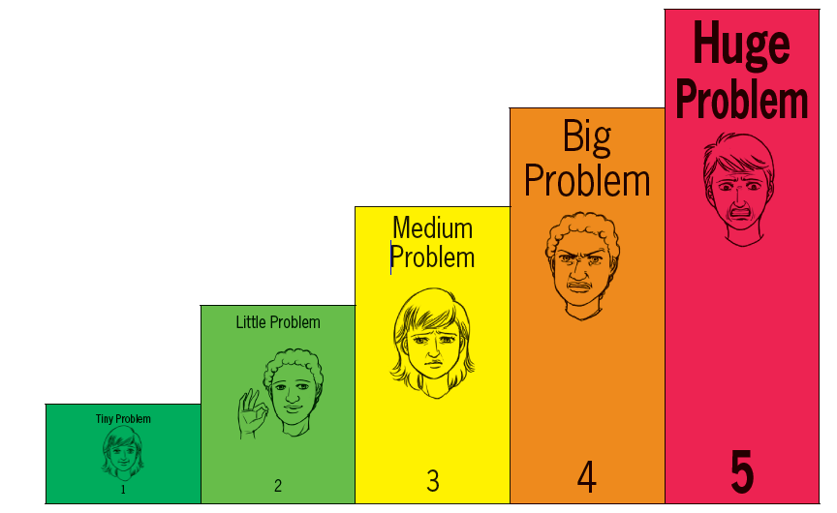
Problems Come in Different Sizes

Slide 7
Little Problems
Little problems are problems that can be solved easily and are no big deal.
Examples include losing a game of basketball, disagreeing about what game to play, wanting to play different games at recess.
If there is a little problem you can:
  Take a deep breath and stay calm.
  Remind yourself that it’s just a little problem.
  Talk it out with your friend.
  Or _________________________.
Can you solve little problems on your own or do you need the help of an adult?

Slide 8
Remember, you don’t have to attend every argument you’re invited to.

Slide 9
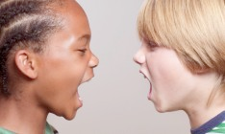
Medium Problems
Medium problems are problems that take longer to solve and may include more people.
Examples include friends having an argument, gossip, and mean-spirited teasing.
For a medium sized problem, you should problem solve.
Why is it important to resolve or come up with a solution to a medium size conflict?

Slide 10
Big Problems
Big problems are problems that are a big deal and are hard to solve on your own.
Big problems usually involve somebody being unsafe or somebody getting hurt.
  What are some examples of big problems?
You should seek help from an adult right away when there is a big problems.
  When you tell an adult about a big problem, is this reporting or tattling? Why?

Slide 11

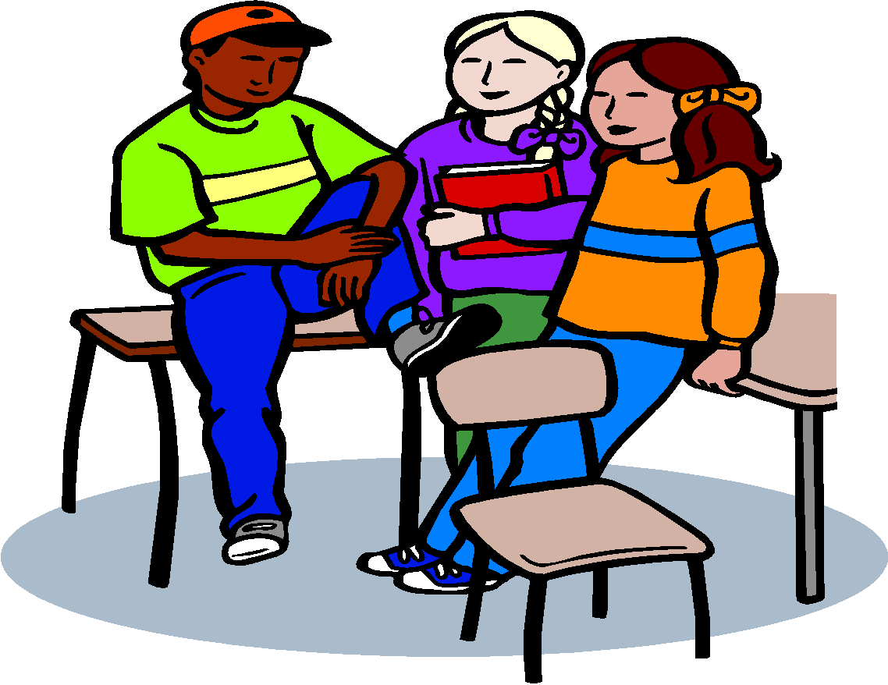

Conflict Resolution Steps
Stop and calm down.
Talk it over.
Fix it.

Slide 12
Step 1: Stop and Calm Down
Stop what you are doing and calm yourself down.
  This is the most challenging, but most important step. Why do you think this is the case?
Ways to calm down:
  Take deep breaths.
  Take a break and come back to it.
  Remind yourself that things will be okay.
  ________________________.
  ________________________.

Slide 13
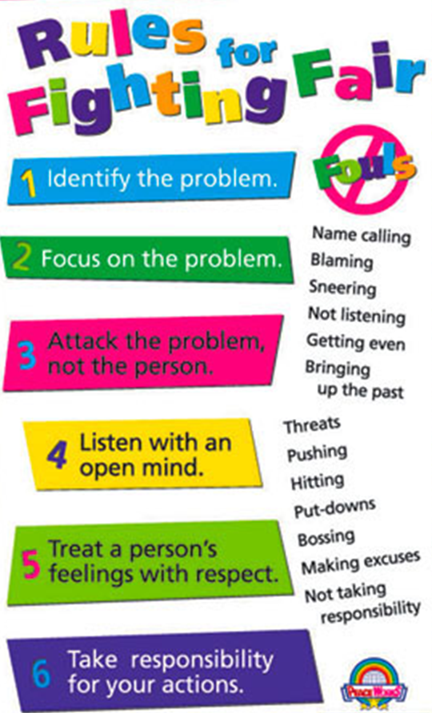
Step 2: Talk
Take turns calmly talking about the problem.
  One person talks at a time.
Use whole body listening to show the other person that you are listening.
  Why is it important to show that you are listening?
Repeat back what the other person said.
  “So you are saying that you are upset that I picked him to be on my team first.”
  Why is this important?

Slide 14
Step 3: Fix It
Think of many different solutions.
  Weigh your options.
Choose the best solution.
Apologize if you hurt someone’s feelings or did something wrong.

Slide 15
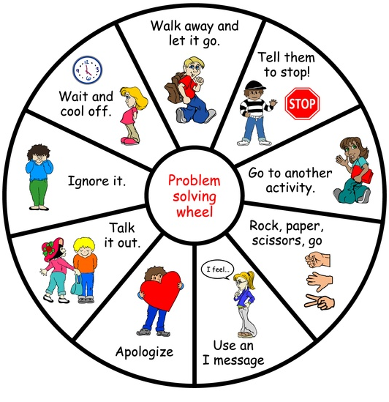
When problems happen, we have many options.
Which of these, do you use?

Slide 16
Practice
Problem: James runs in the hall and bumps into Noah who is holding his science project. The project falls and comes apart. Noah becomes very upset.
  What size problem is this?
  What should James and Noah do at step 1?
  How should James and Noah talk during step 2?
  How should James apologize?
  What are some possible solutions during step 3?

Slide 17
Practice
This week we want you to practice conflict resolution when an issue comes up.
Remember to practice the skills we have just learned.

